Slide 1

Capstone Project-Tableau Bank Data
Churn Analysis
Vaibhav Sirohi
Batch: DA92S9

Slide 2
Agenda
1
2
3
4
5
Introduction
Business objective
ANALYSIS
Dashboard Report
Conclusion Key point To focus

Slide 3

Business objective
To reduce the bank's customer loss rate.
To address credit card customer loss by churn data analysis.

Slide 4

Introduction
Project Objective Analyze the customer data of a North American bank and build an interactive dashboard using Tableau.
Building dashboard will involve analyzing the data and presenting the results using appropriate charts/graphs and provide good insights to make their credit card business better.

Slide 5

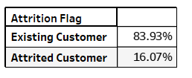
Task 1: Display the percentage of the attrited and the existing customers from the data.
Bank has 16.07% new customers and 83.93% existing customers associated with them.
So, the text representation shows the Percentage of Attrited and Existing Customer
% of Total Count of Attrition Flag broken down by Attrition Flag.

Slide 6

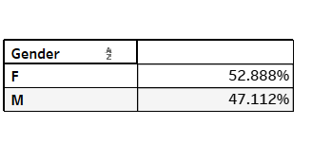
Task 2: Display gender-wise percentage of the attrited and the existing customers.
There are more no of females around 52.88% that are associated with bank.
% of Total Count of Attrition Flag broken down by Gender. The view is filtered on % of Total Count of Attrition Flag, which ranges from 47.112% to 52.888%.

Slide 7
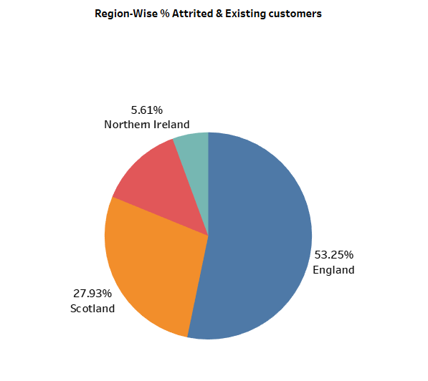
Task 3: Display region-wise percentage of the attrited and the existing customers.
Region England has the highest 53.25 % of Total Count of customer Attrition Flag engagement among other region user.

Slide 8

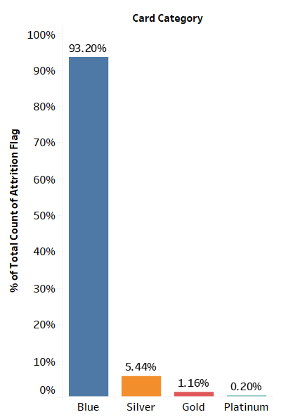
Task 4: Display the percentage of the attrited and the existing customers for each card category.
Card Category blue has the highest 93.20% count of Attrition Flag among all the other cards.

Slide 9

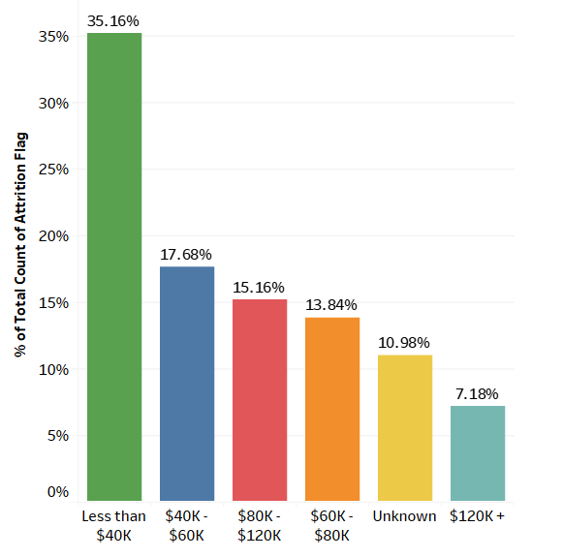
Task 5: Display the percentage of the attrited and the existing customers for each income category.
Income category with less than $40k has most no of customer with 35.16% .

Slide 10

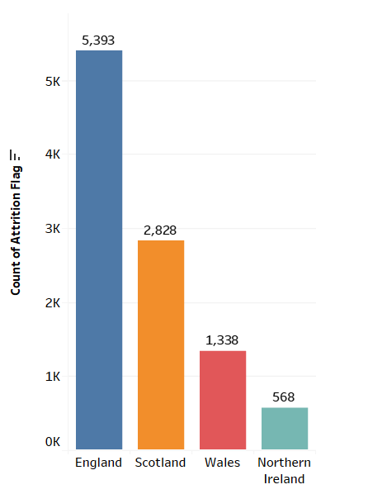
Task 6: Display region-wise count of customers. Identify the region that has the maximum number of customers.
Count of Attrition Flag broken down by Region. England Has the Highest no of Region wise Customer count 5393.

Slide 11
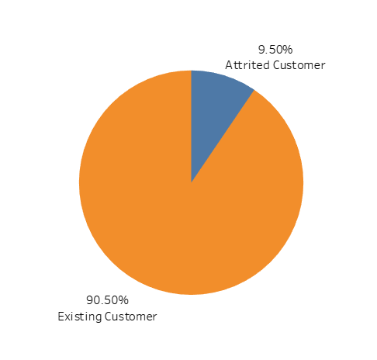
Task7:To display the Average Utilization Ratio by Attrited & Existing Customers
Existing customers has the Highest 90.5% of average utilization ratio of credit card wise Customer.

Slide 12
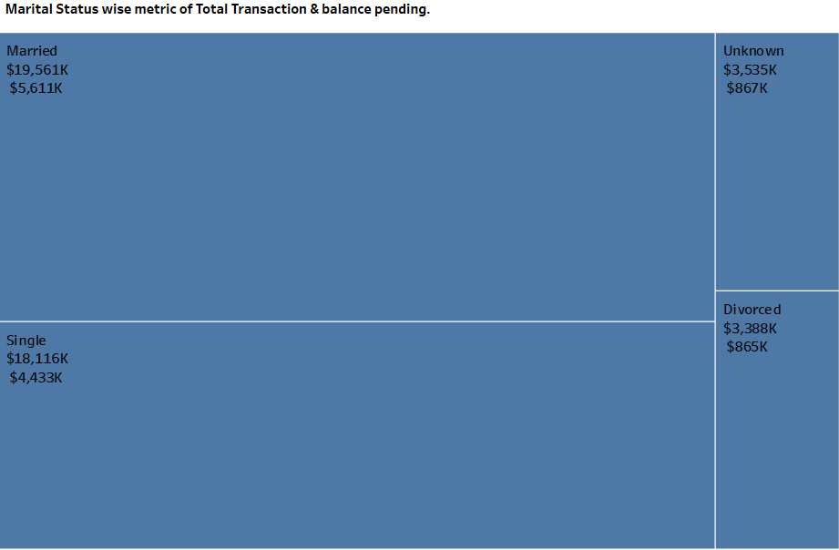
Task 8: Display the Marital Status wise Total Transaction & pending balance.
Married people and single people has the most no of transaction and dues of credit card.

Slide 13
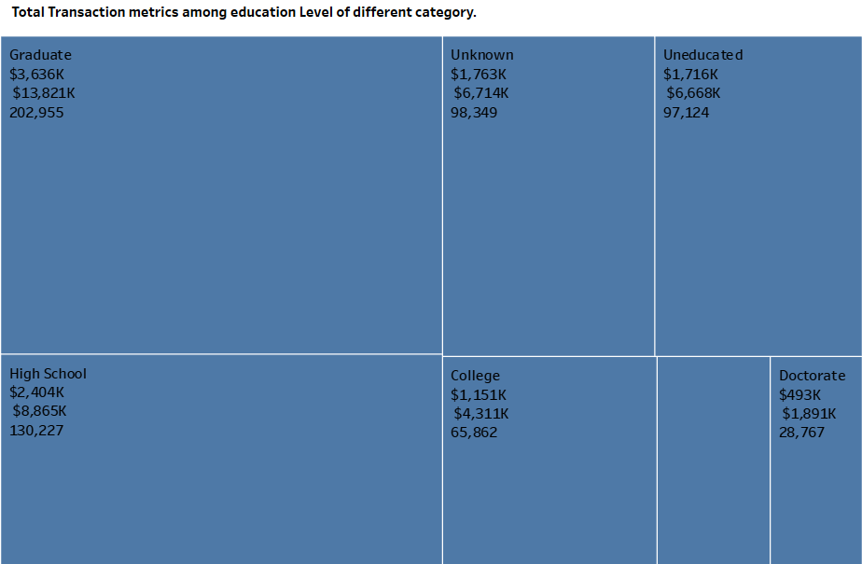
Task 9: Display the Total Transaction metrics among education Level of different category.
Graduates and high school level in education has most bills, transaction count and spending.

Slide 14
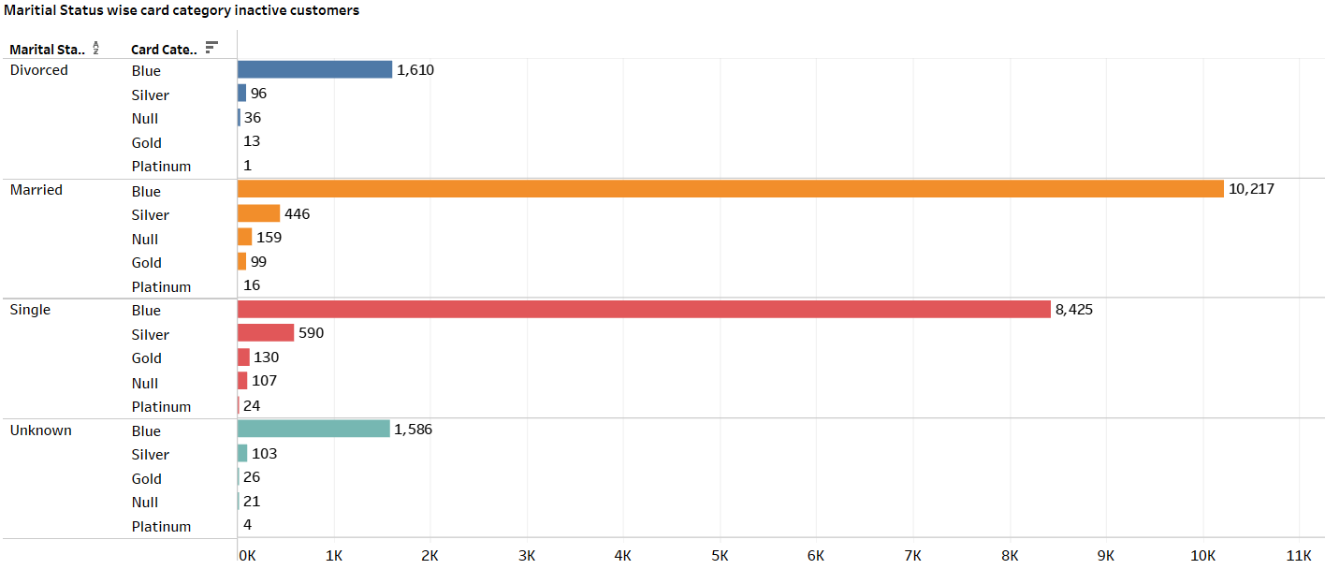
Task10 :Display the Marital Status wise card category inactive customers.
Among all card category blue category is among top inactive and married category status are the one that have top inactive customers with blue card.

Slide 15
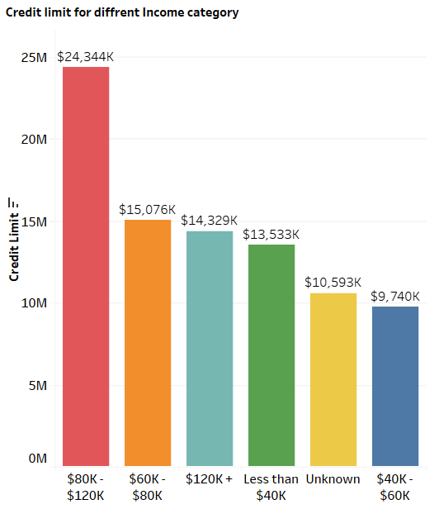
Task11. Display the sum of Credit limit for different Income category.
The Income category $80k - $120k has the Highest credit limit among other.

Slide 16
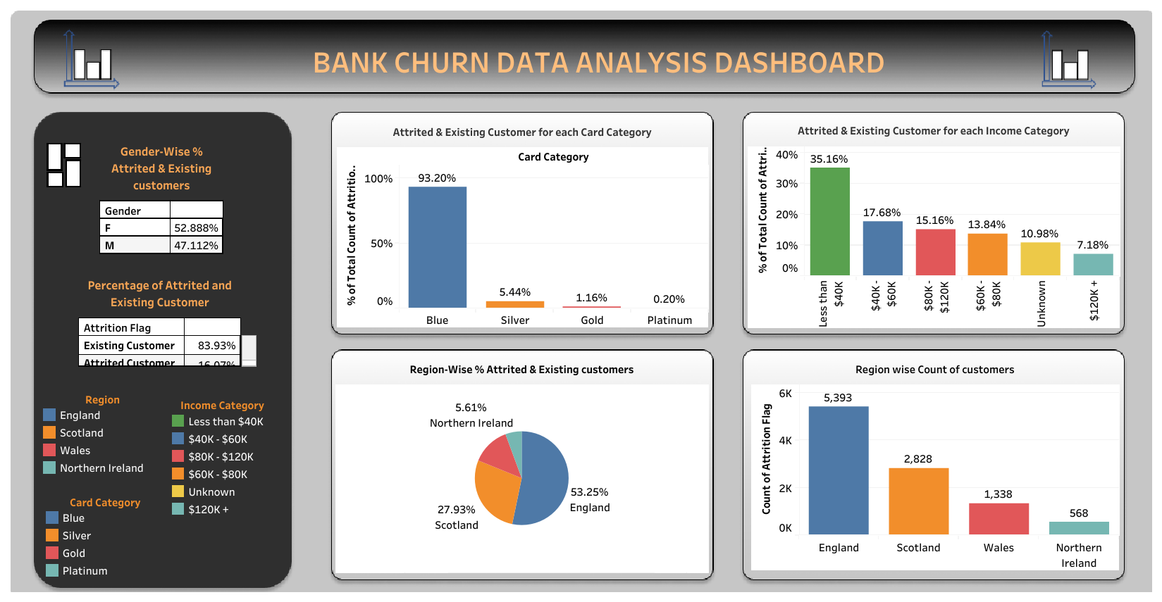

Slide 17
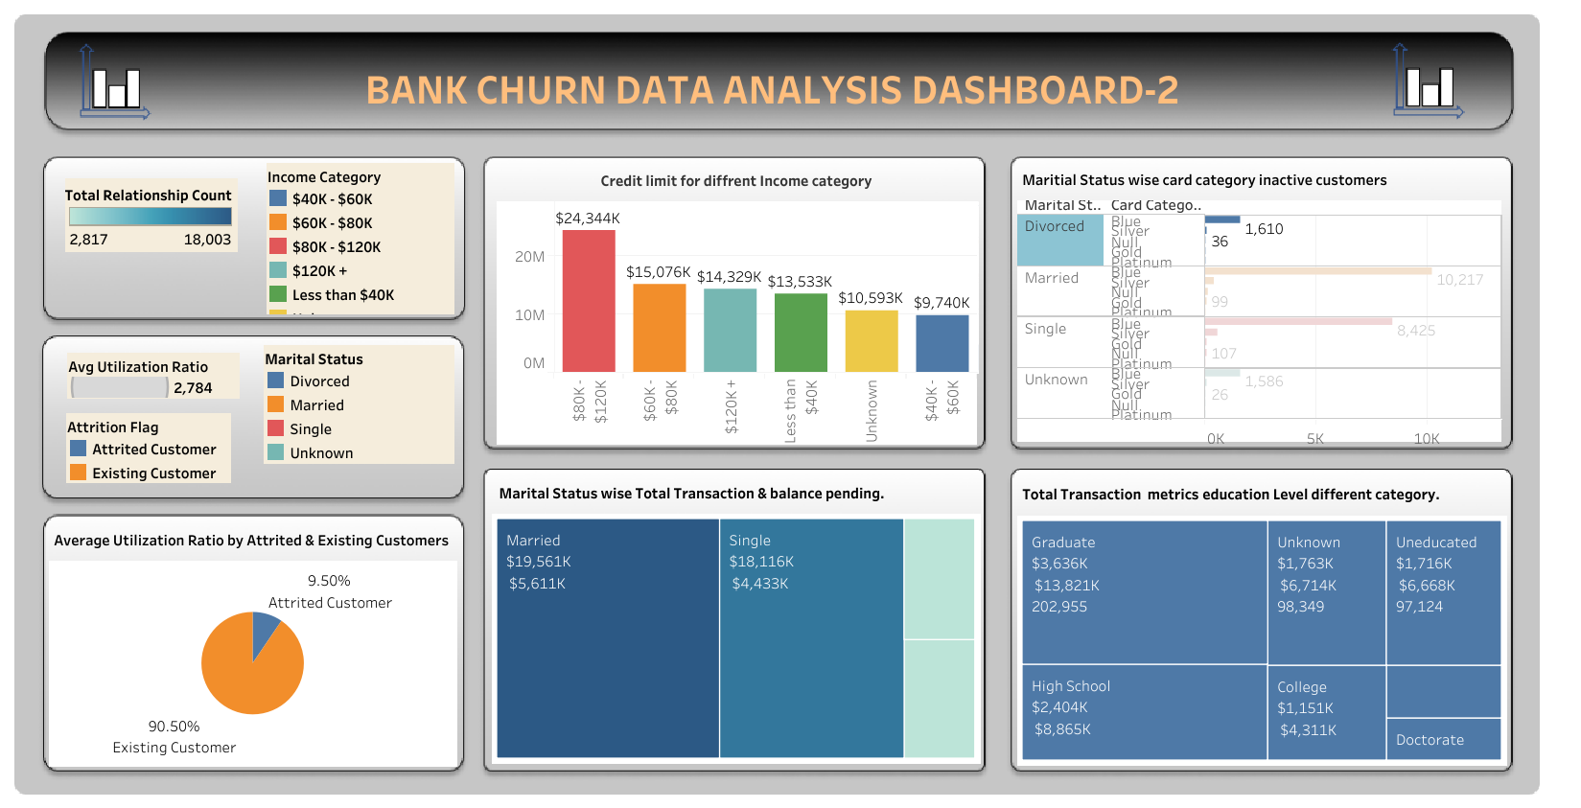

Slide 18

Conclusion
Summary Highlights Key Information
Task 1 - Customer Attrition Percentage:
New Customers: 16.07% , Existing Customers: 83.93%
Task 2 - Gender-wise Percentage:
Females: 52.88%, Males: 47.11%
Task 3 - Region-wise Attrition Percentage:
Region with Highest Attrition: England (53.25%)
Task 4 - Card Category Attrition Percentage:
Blue Card Category: 93.20% (Highest)
Task 5 - Income Category Attrition Percentage:
Income < $40k: (35.16% (Highest))
Task 6 - Region-wise Customer Count:
Region with Most Customers: England (5,393)
Task 7 - Average Utilization Ratio:
Existing Customers: 90.5% (Highest)
Task 8 - Marital Status Transaction and Dues:
Marital Status (Married and Single): Most transactions and dues.
Task 9 - Education Level Transaction Metrics:
Education Levels: Graduates and high school has most transaction count and spending.
Task 10 - Marital Status Inactive Customers:
Marital Status are among top Inactive customers with blue cards category.
Task 11 - Credit Limit by Income Category:
Income Category "$80k - $120k“ has Highest credit limit.
By tableau analysis the various aspect and came up with some valuable insights into the bank's credit card customer base.
The bank should focus on consider following aspects to gain customers.
Personalized marketing campaigns, targeted promotions,
Product offerings based on demographics, region, card category, income level and customer behavior.
Maintaining a customer-centric approach and
Continuously improving customer experience will be essential in building long-lasting relationships with cardholders.

Slide 19
Some more Areas of focus for bank based on above data insights.
Regular Analysis: Continuously analyze data and market trends, evaluating the effectiveness of strategies and product changes.
Risk Management: Utilize data analytics to identify credit risks early and proactively mitigate potential losses.
Innovation: Embrace technology with digital wallets, mobile apps, and contactless payments to meet evolving customer needs.
Credit Limit Management: Adjust credit limits based on behavior, offering limit increases to responsible customers for increased card usage.
Customer Feedback: Collect attrited customers' feedback to enhance customer service and card features for improved customer experience.

Slide 20
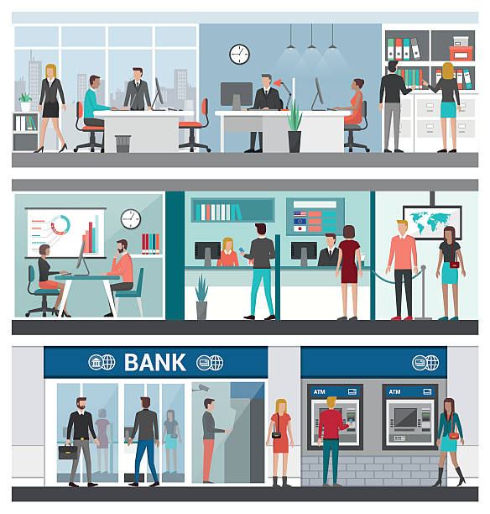
Thank you
Vaibhav Sirohi
Batch: DA92S9

